Slide 1
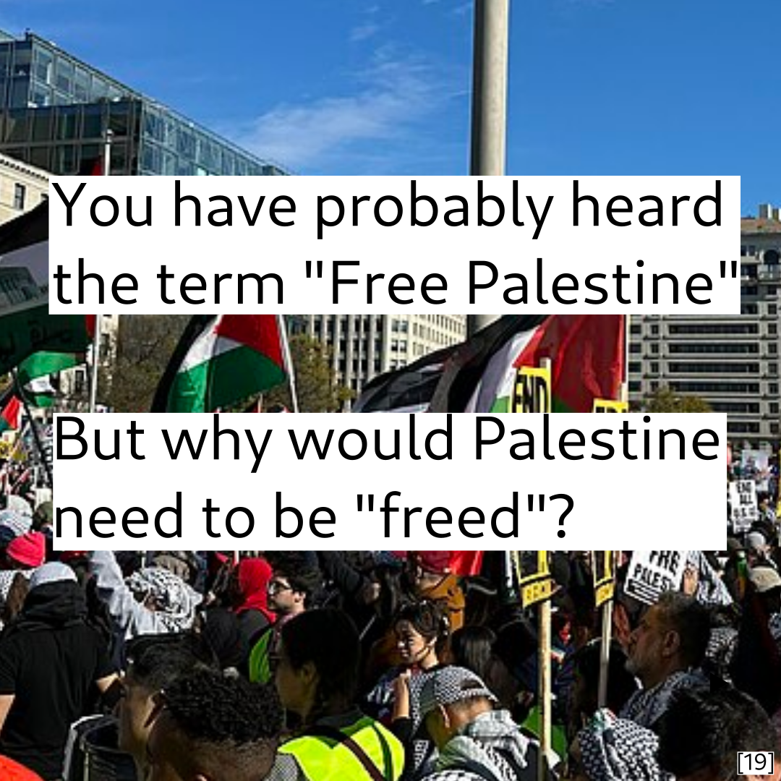

Slide 2
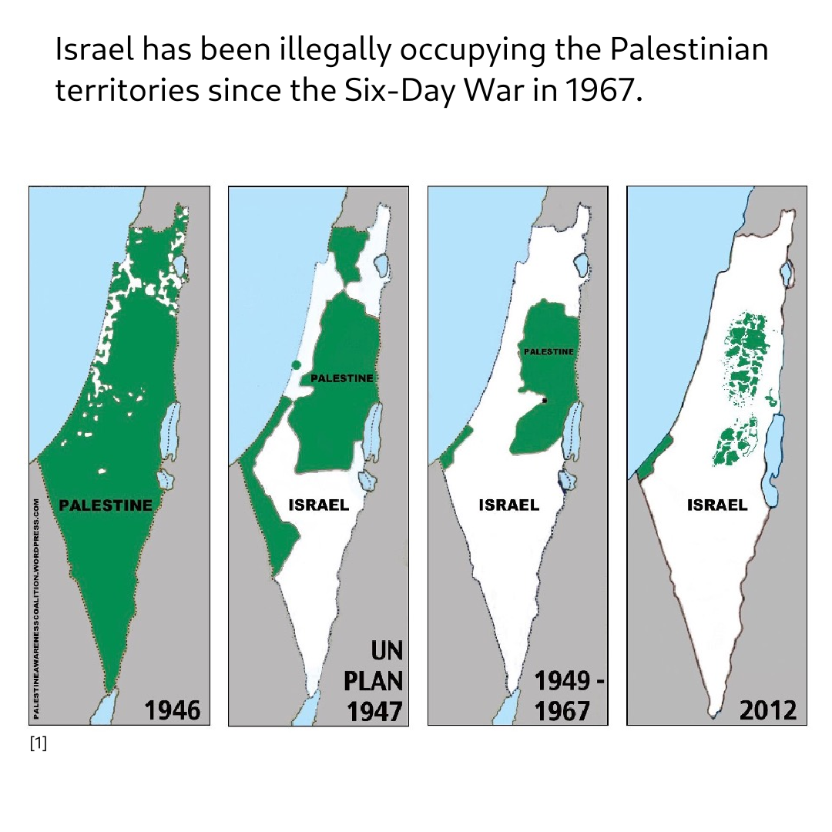

Slide 3
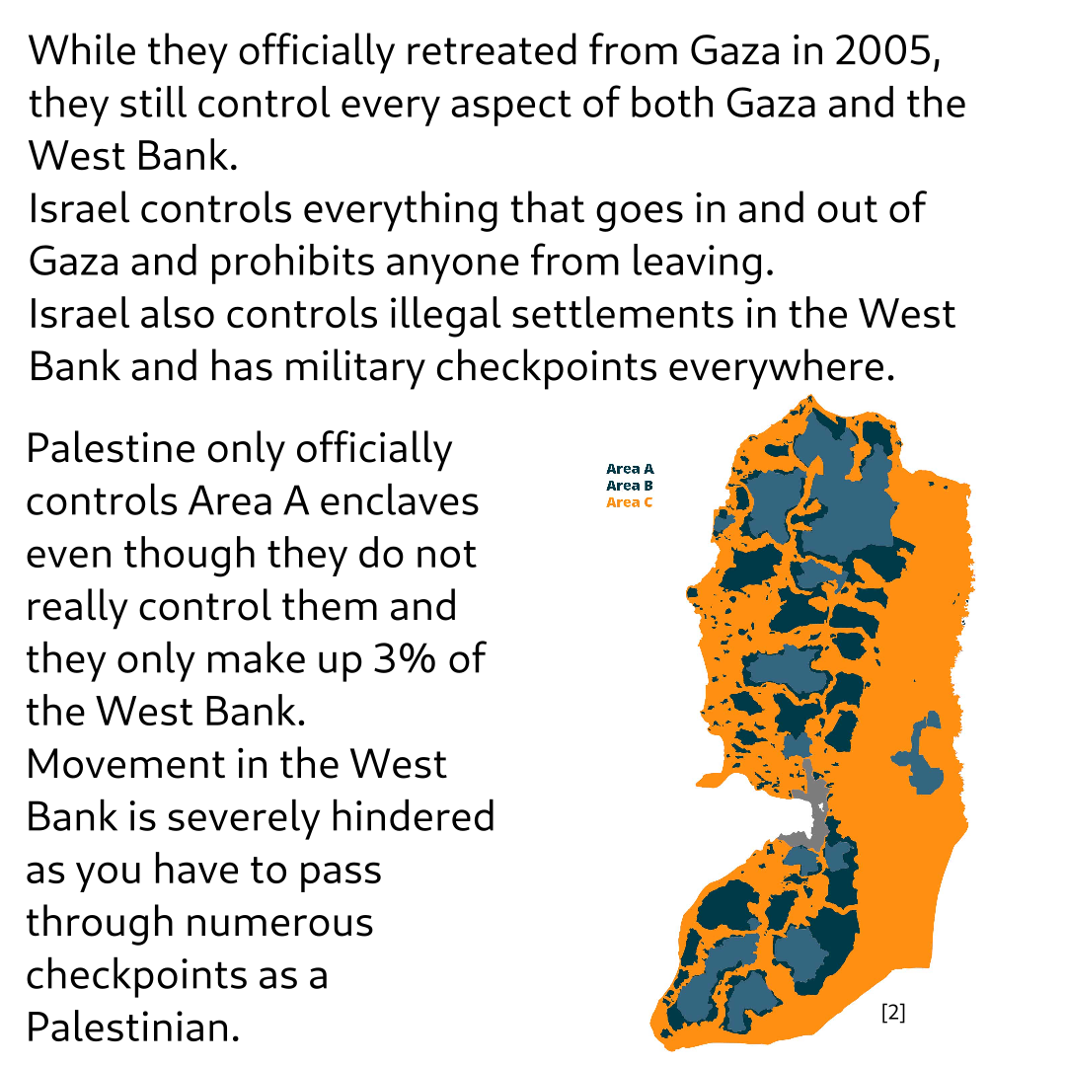

Slide 4
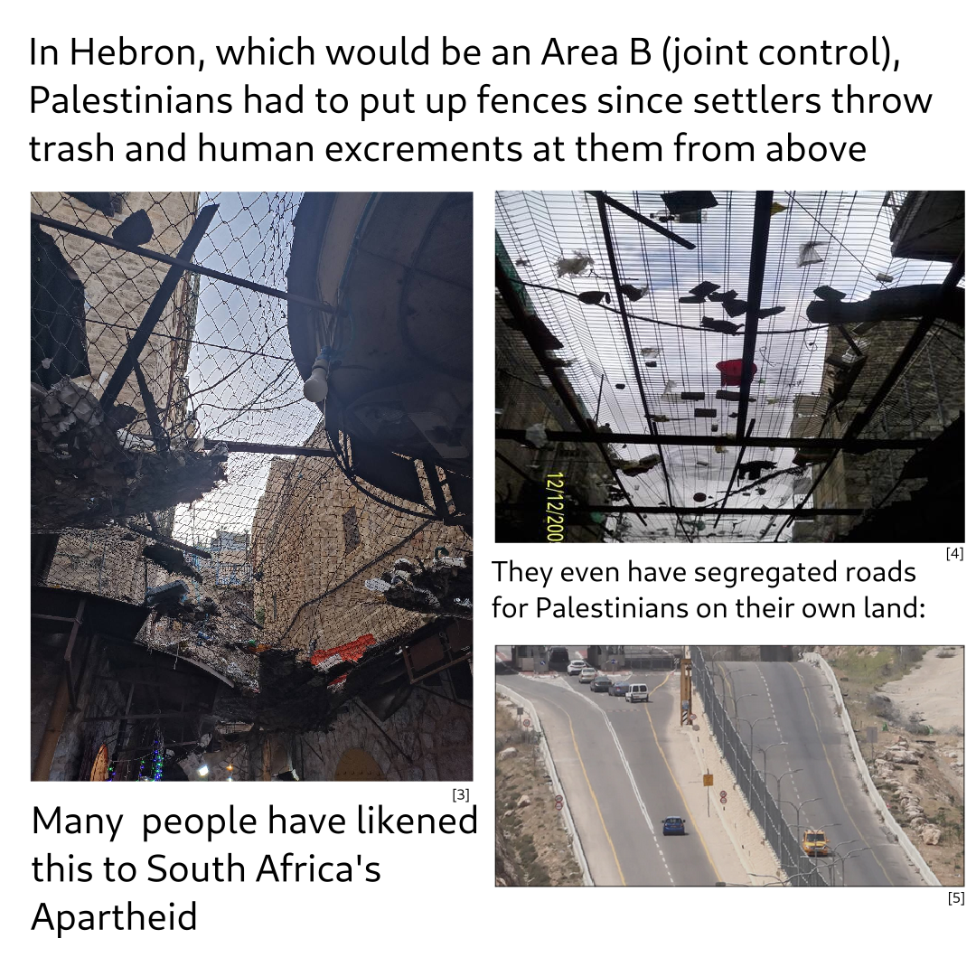

Slide 5
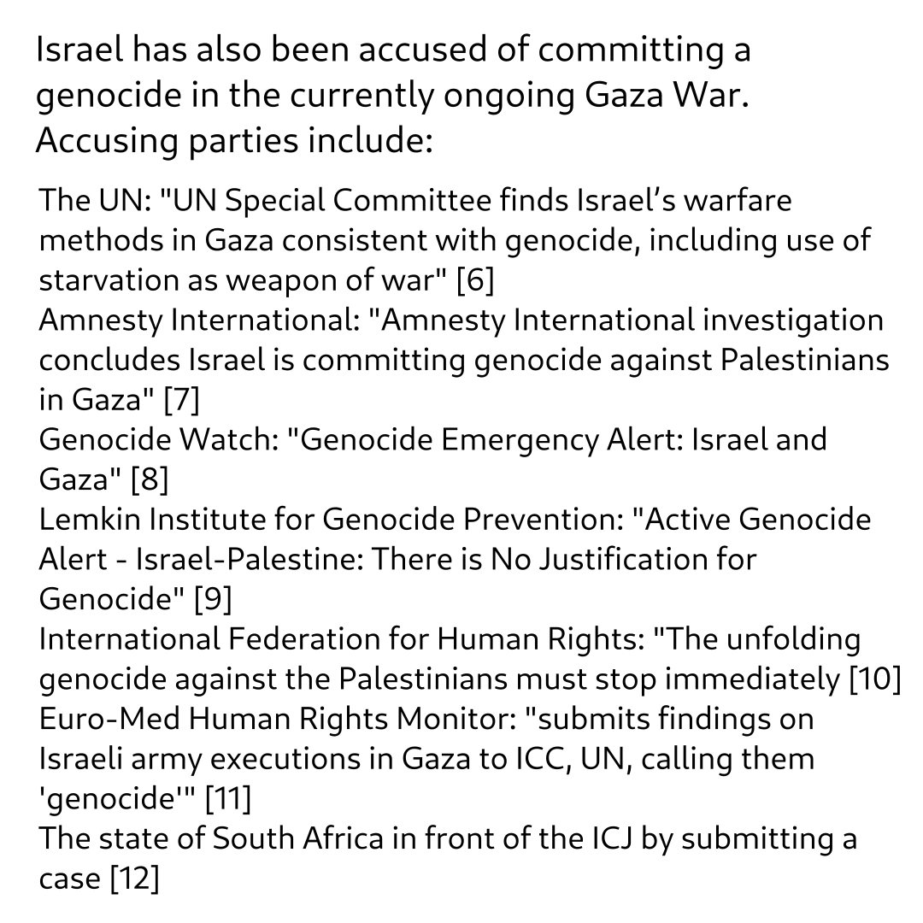

Slide 6
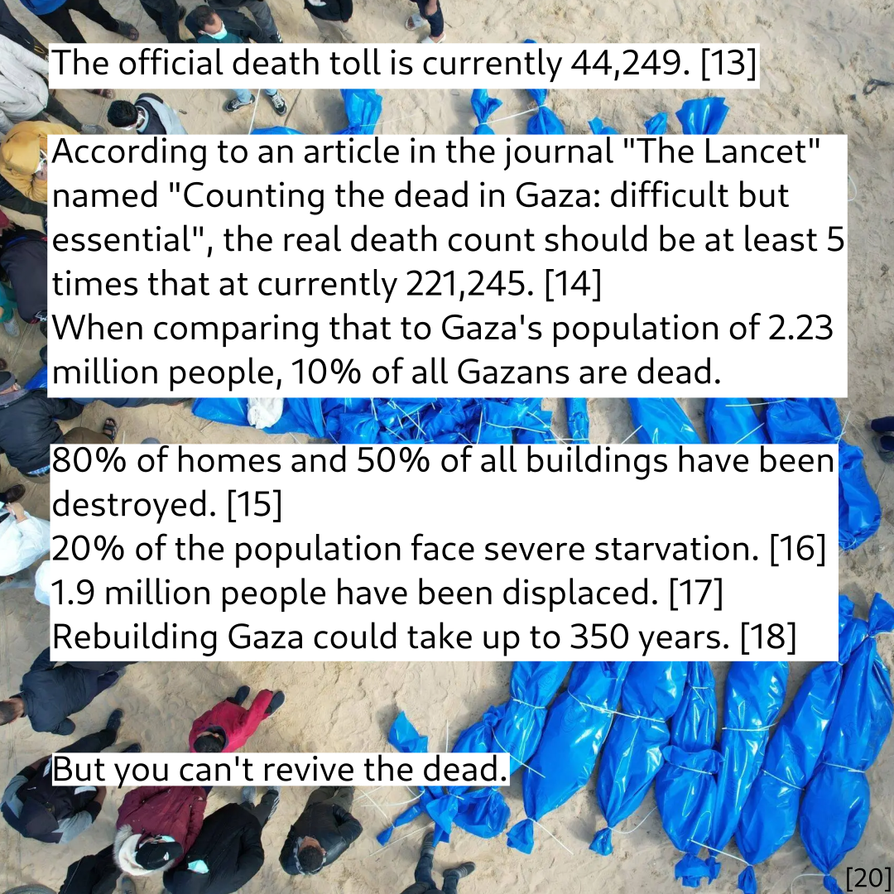

Slide 7
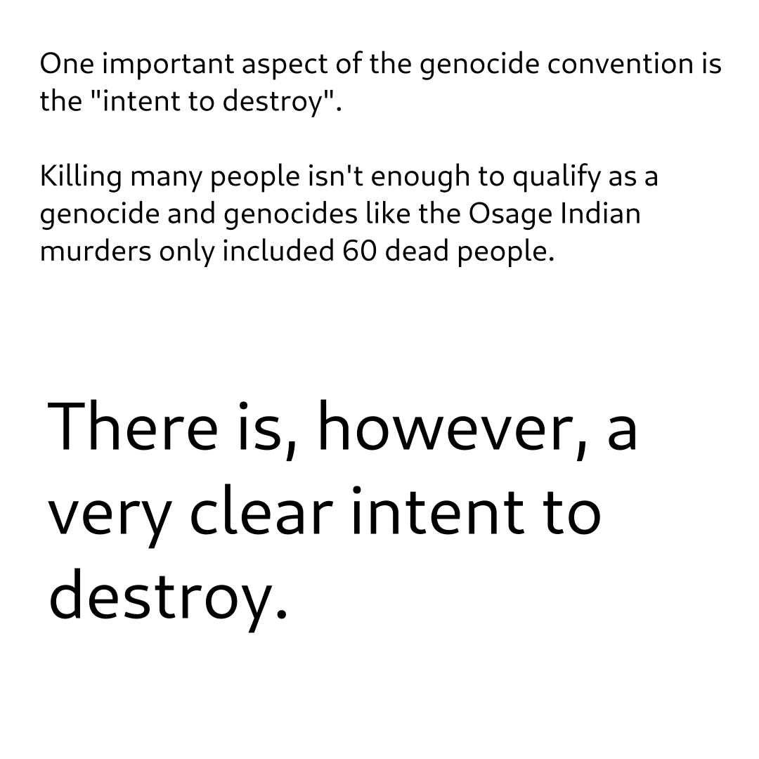

Slide 8


Slide 9
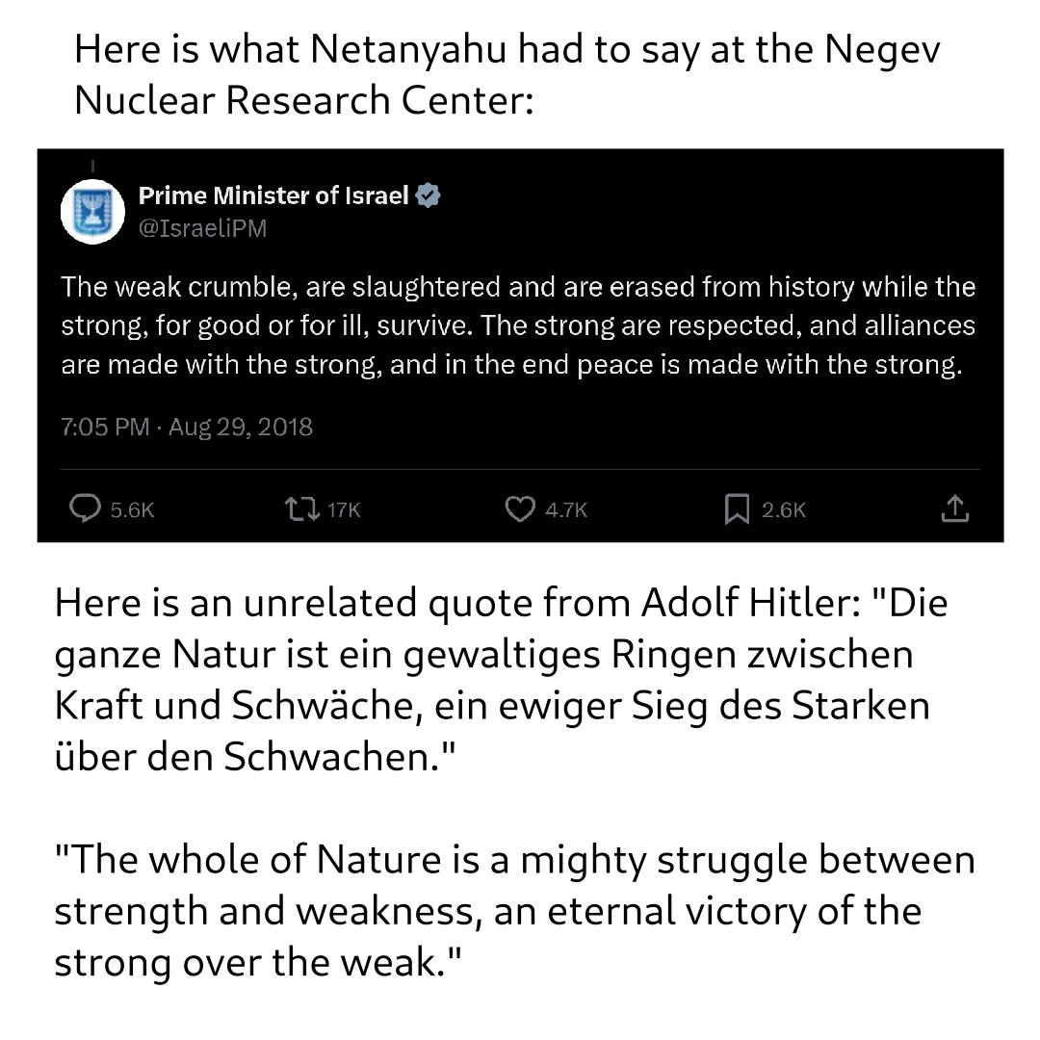

Slide 10
They say "Free Palestine" but why?
Further reading:
https://www.amnesty.org/en/documents/mde15/8668/2024/en/
https://www.ohchr.org/en/documents/thematic-reports/a79363-report-special-committee-investigate-israeli-practices-affecting
https://www.btselem.org/publications/202408_welcome_to_hell
Sources:
[1] https://blog.richmond.edu/livesofmaps/2023/12/18/map-of-the-week-unraveling-the-borders-of-israel-and-palestine-through-time/
[2] https://www.anera.org/what-are-area-a-area-b-and-area-c-in-the-west-bank/
[3] https://www.disorient.de/magazin/palestine-hebron-settlements-apartheid-colonization
[4] https://observers.france24.com/en/20100910-hebron-palestinian-shopkeepers-are-drowning-rubbish-israeli-settlers
[5] https://www.nrc.no/shorthand/stories/in-the-west-bank-segregated-roads-displace-palestinians/index.html
[6] https://www.ohchr.org/en/press-releases/2024/11/un-special-committee-finds-israels-warfare-methods-gaza-consistent-genocide
[7] https://www.amnesty.org/en/latest/news/2024/12/amnesty-international-concludes-israel-is-committing-genocide-against-palestinians-in-gaza/

Slide 11
[8] https://www.genocidewatch.com/single-post/genocide-emergency-alert-israel-and-gaza
[9] https://www.lemkininstitute.com/active-genocide-alert-1/active-genocide-alert---israel-palestine:-there-is-no-justification-for-genocide
[10] https://www.fidh.org/en/region/north-africa-middle-east/israel-palestine/the-unfolding-genocide-against-the-palestinians-must-stop-immediately
[11] https://www.middleeastmonitor.com/20231226-euro-med-submits-findings-on-israeli-army-executions-in-gaza-to-icc-un-calling-them-genocide/
[12] https://www.icj-cij.org/case/192
[13] https://www.ochaopt.org/content/reported-impact-snapshot-gaza-strip-26-november-2024
[14] https://www.thelancet.com/journals/lancet/article/PIIS0140-6736(24)01169-3/fulltext
[15] https://www.tandfonline.com/doi/full/10.1080/14623528.2024.2306714
[16] https://www.theguardian.com/world/article/2024/jun/24/gaza-households-hunger-draft-un-report
[17] https://www.hrw.org/news/2023/12/18/israel-starvation-used-weapon-war-gaza
[18] https://www.theguardian.com/world/2024/oct/22/ruined-gaza-economy-un-report-israel
[19] https://commons.wikimedia.org/wiki/File:March_on_Washington_Free_Palestine_-_2.jpg
[20] https://www.middleeastmonitor.com/20240130-palestinians-bury-dozens-in-gaza-after-israel-hands-over-bodies/

Slide 12
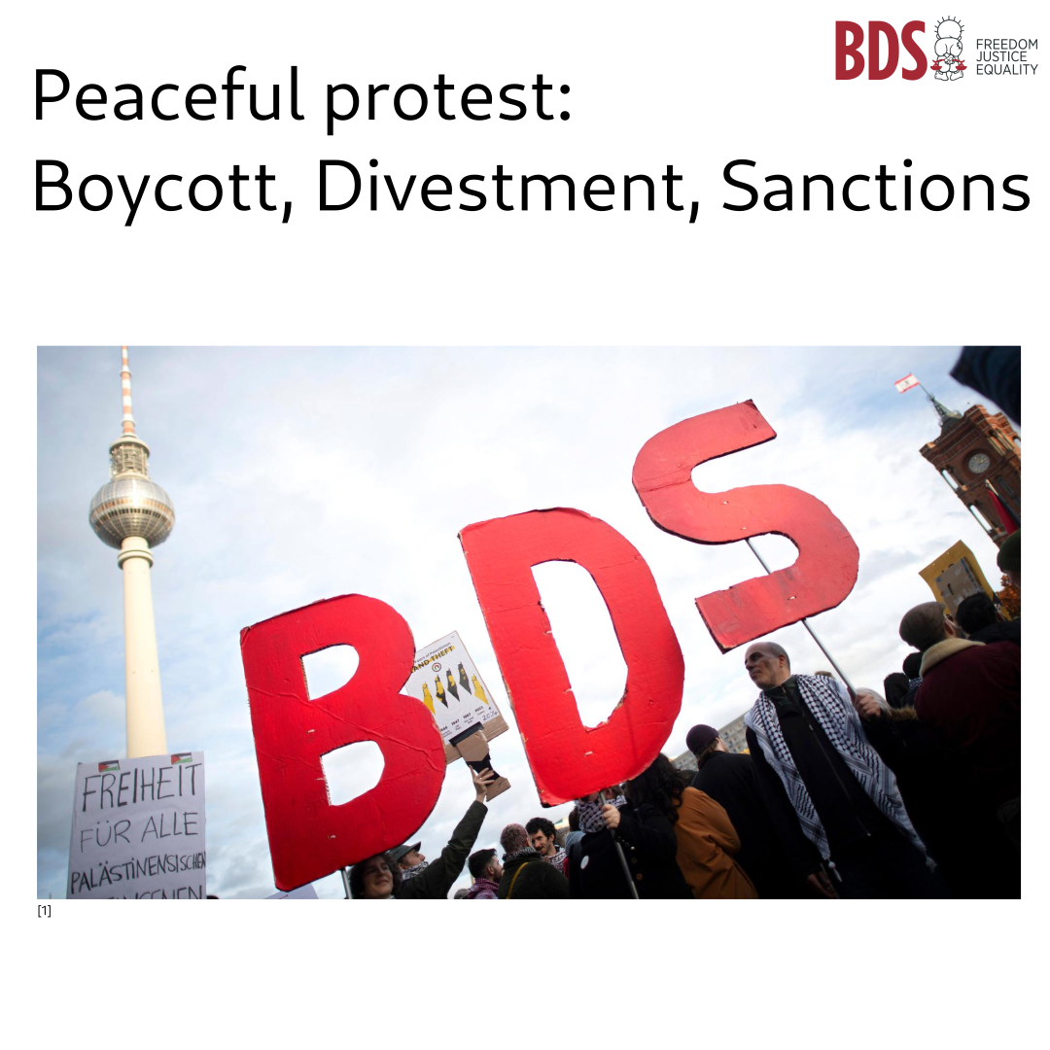

Slide 13
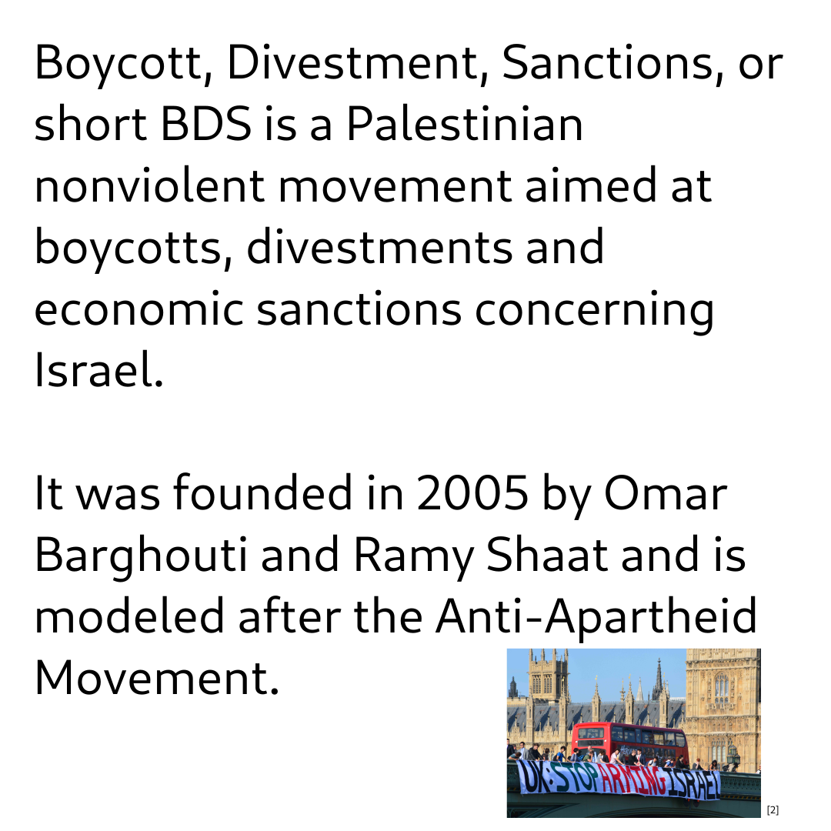

Slide 14
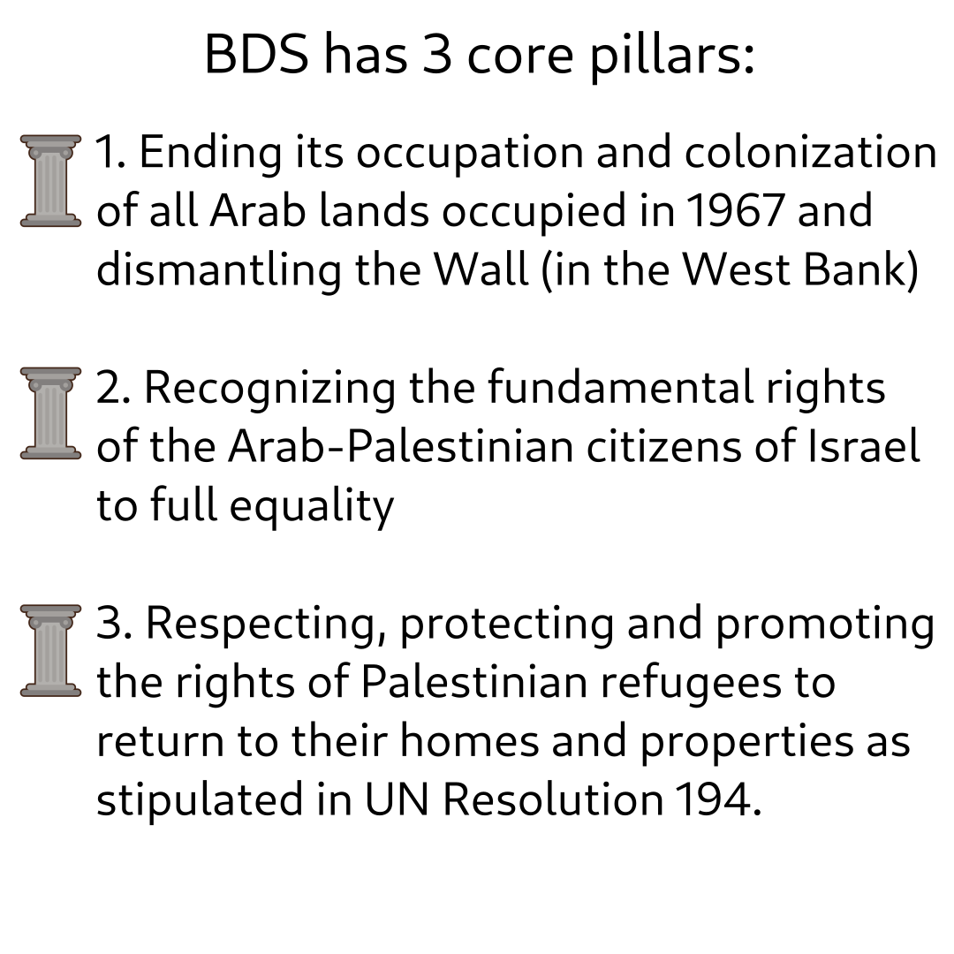

Slide 15
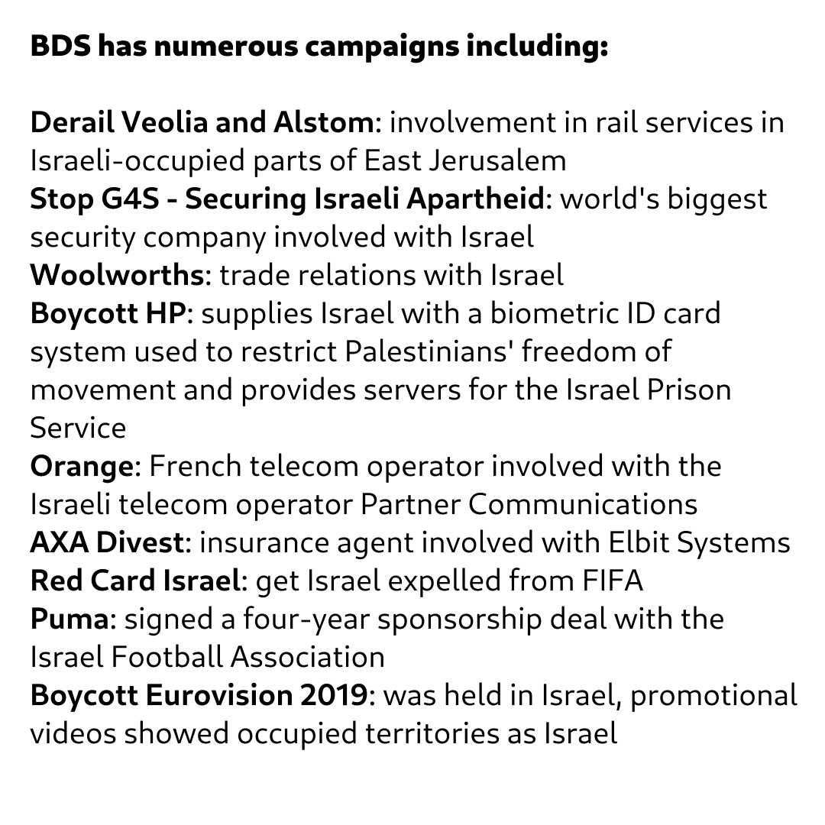

Slide 16
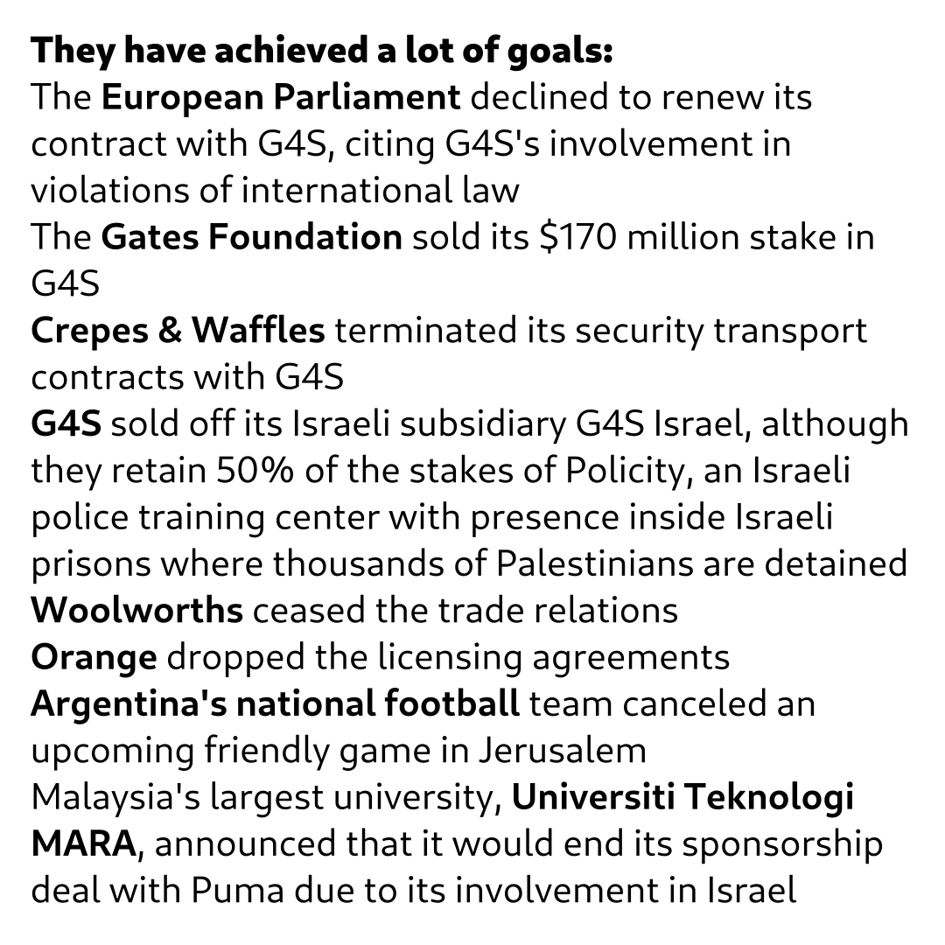

Slide 17
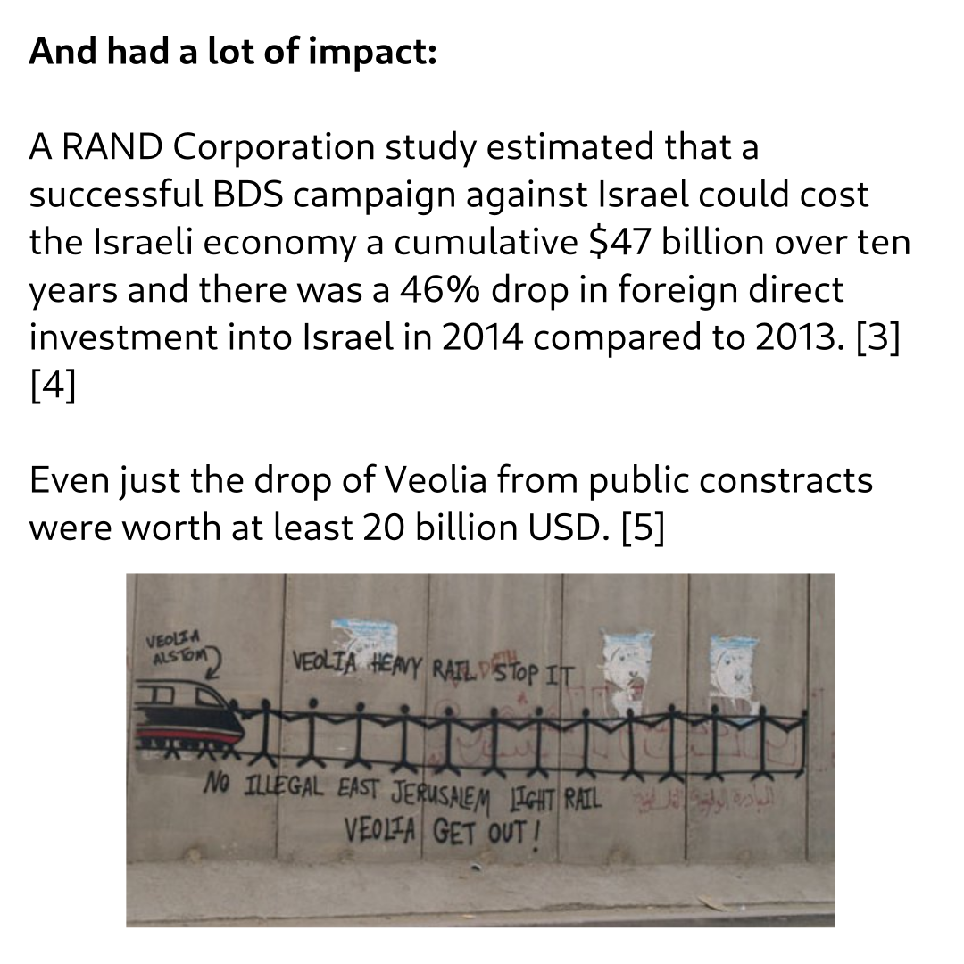

Slide 18


Slide 19
@bds.movement
Main website: https://bdsmovement.net/
Sources:
[1] https://www.deutschlandfunk.de/israelkritische-bewegung-bds-ist-extremistischer-verdachtsfall-100.html
[2] https://bdsmovement.net/news/saturday-november-29th-%E2%80%93-uk-stop-arming-israel-day-action
[3] https://books.google.de/books?id=Wf3DCgAAQBAJ&pg=PT278&redir_esc=y#v=onepage&q&f=false
[4] https://bdsmovement.net/impact
[5] https://bdsmovement.net/news/bds-marks-another-victory-veolia-sells-all-israeli-operations
[6] https://bdsmovement.net/BDS-Has-Partnered-With-Boycat-App

Slide 20
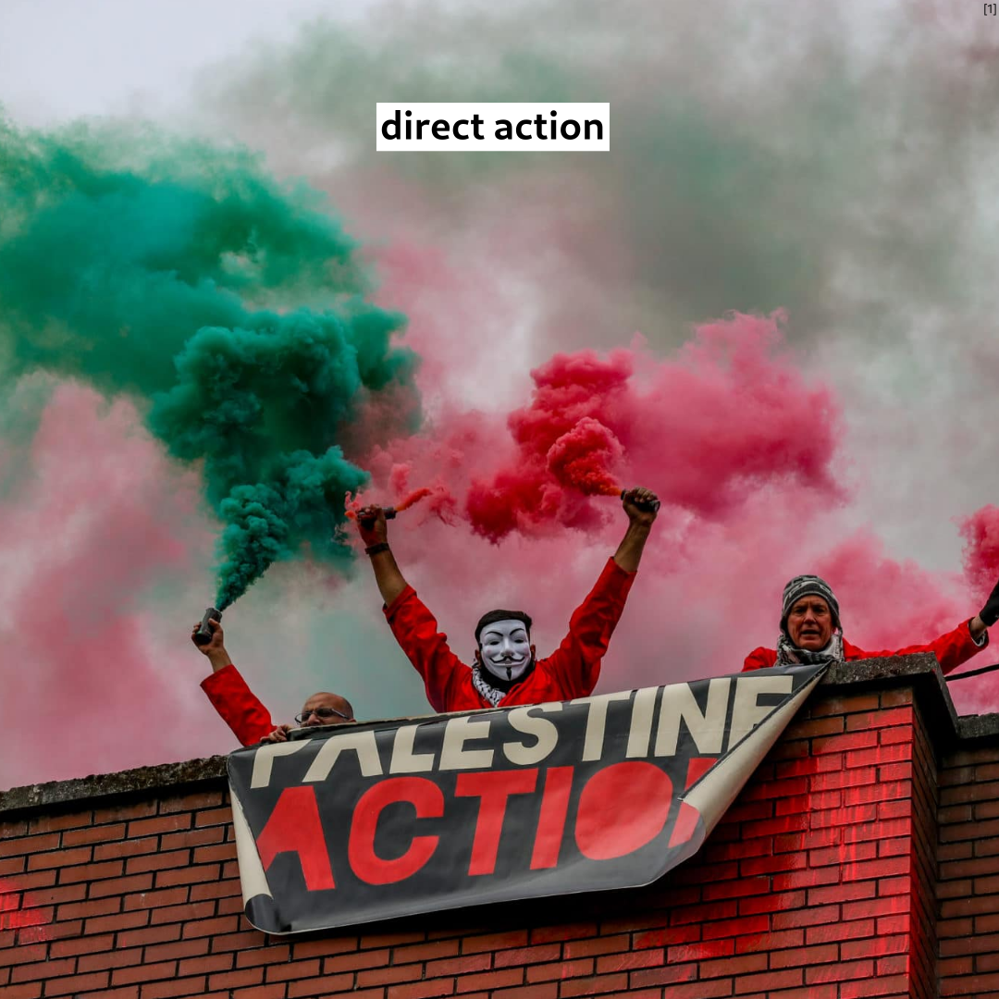

Slide 21
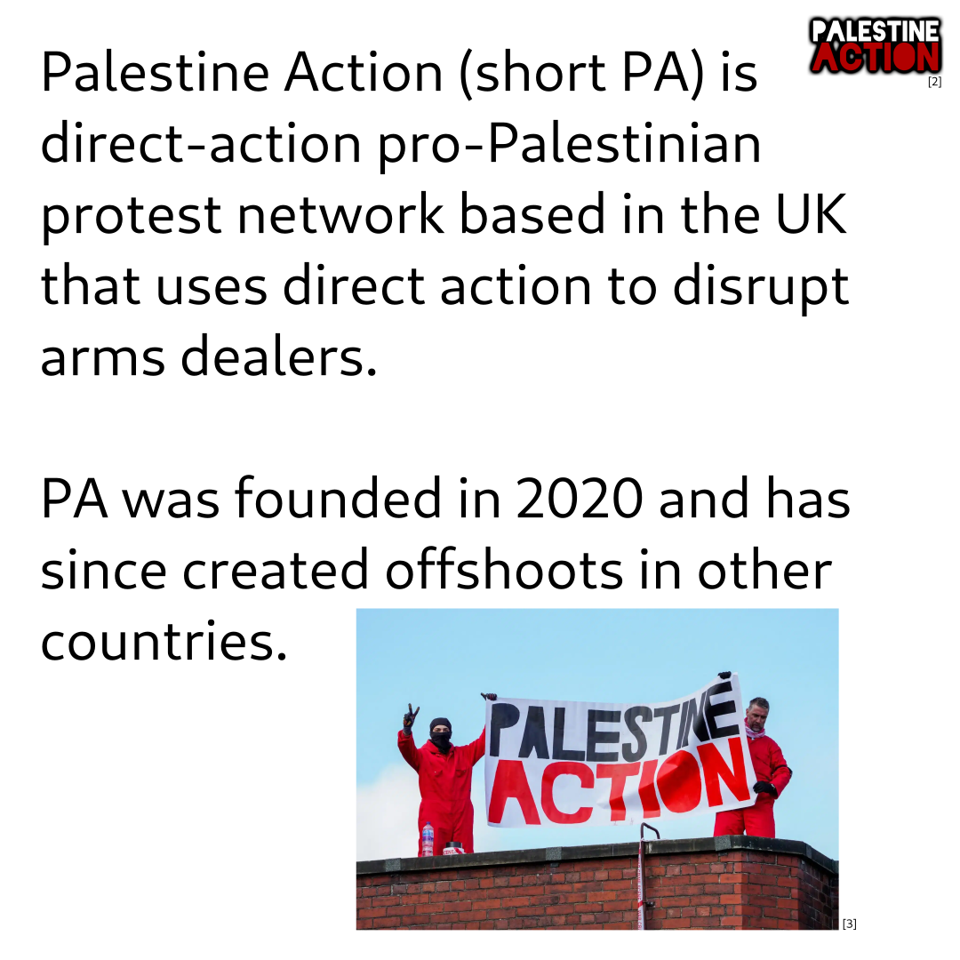

Slide 22
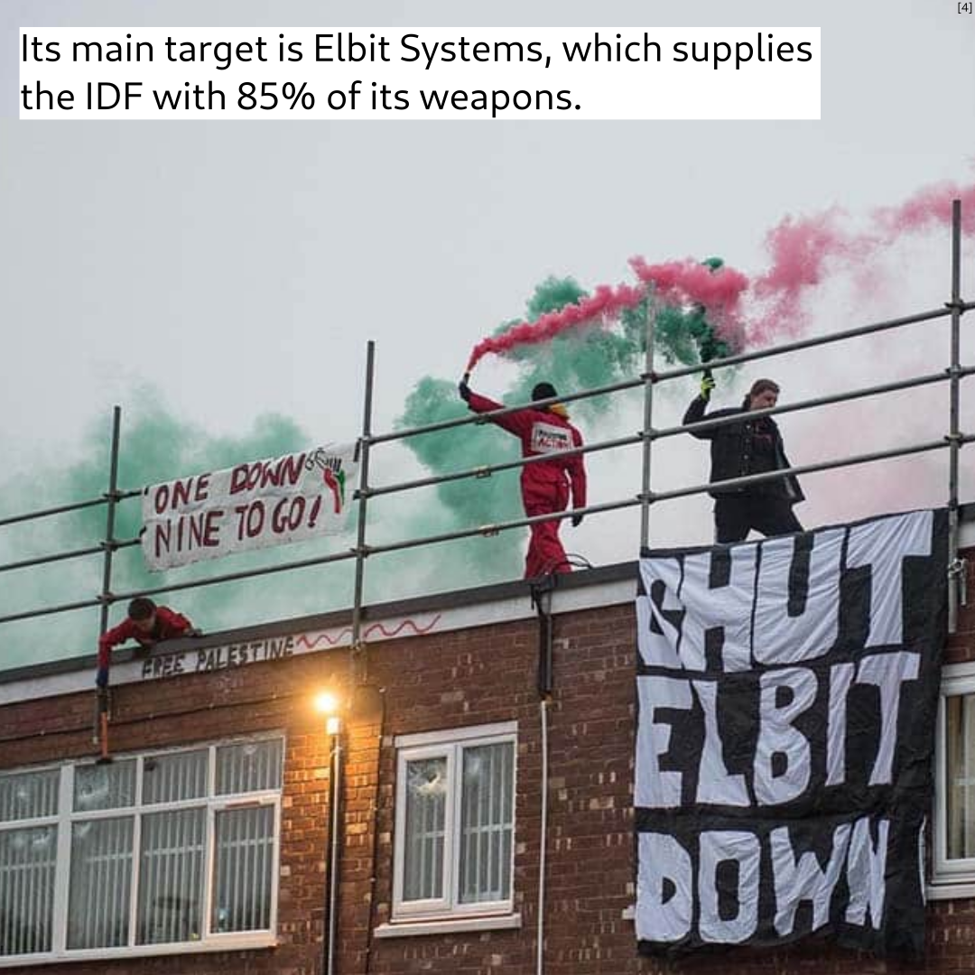

Slide 23
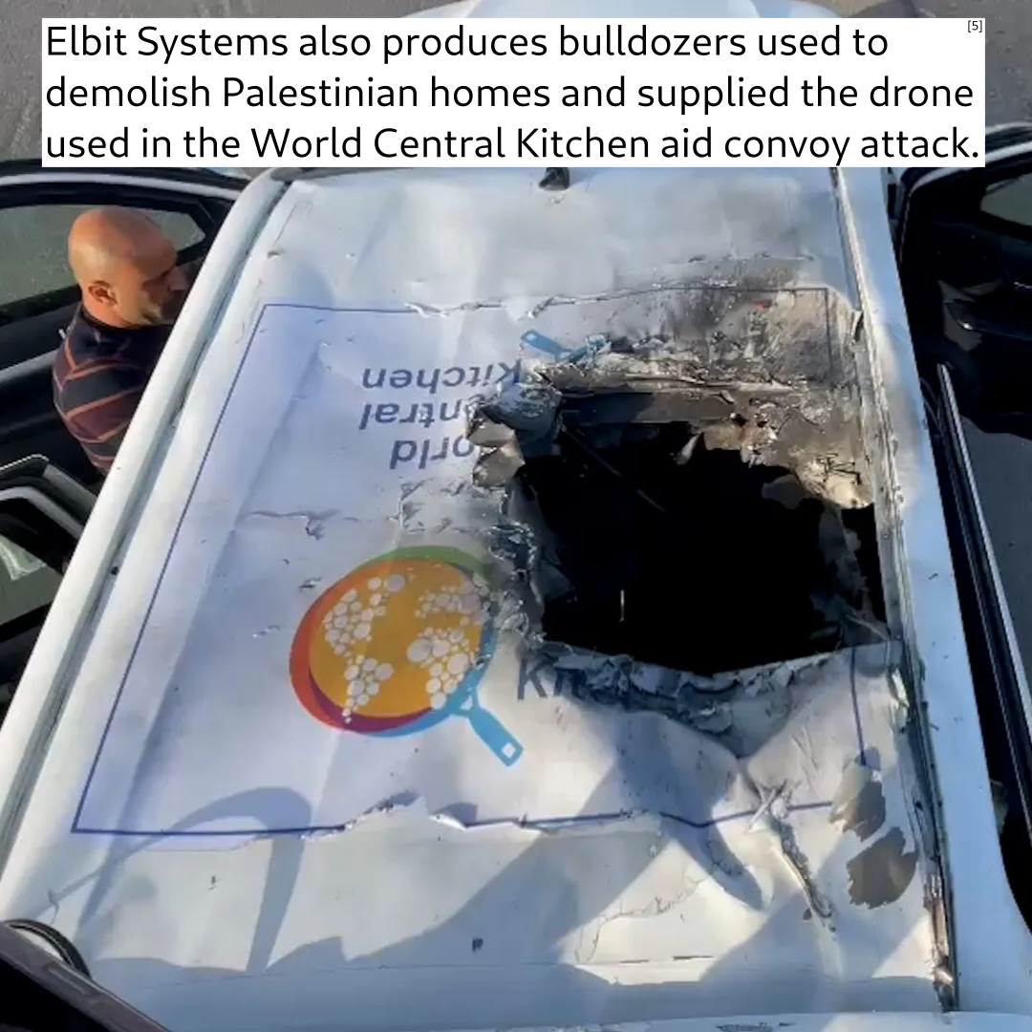

Slide 24
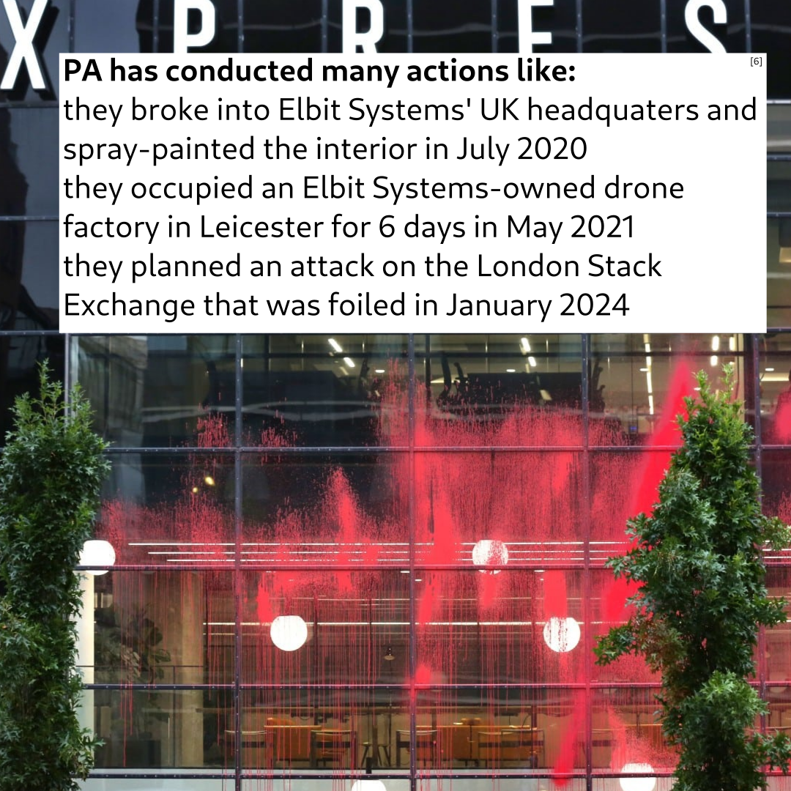

Slide 25
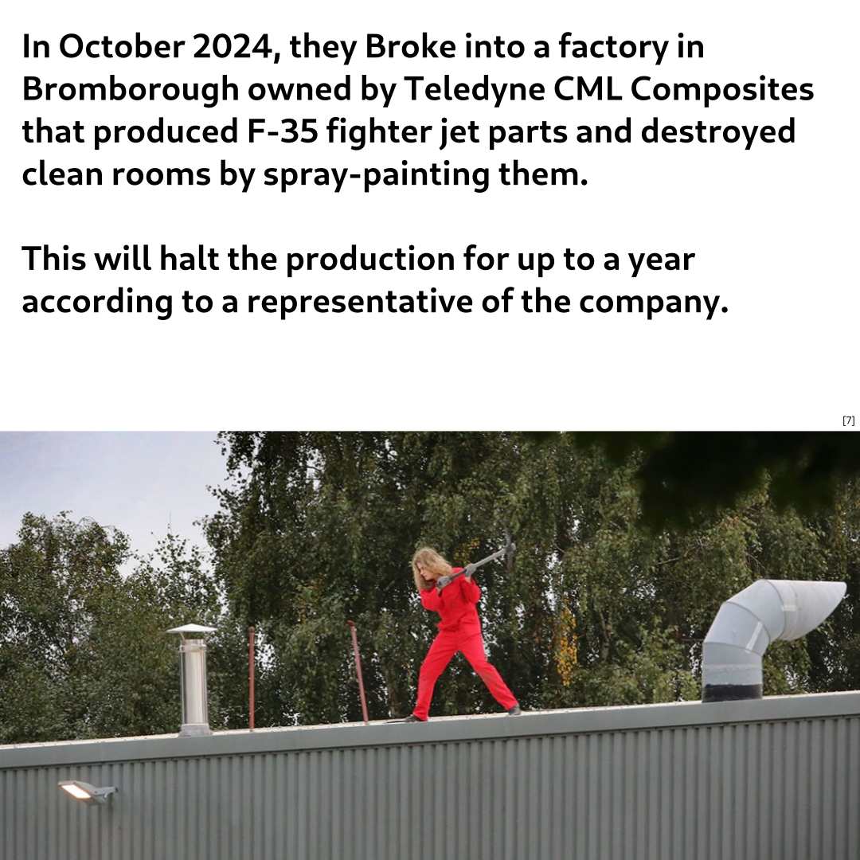

Slide 26
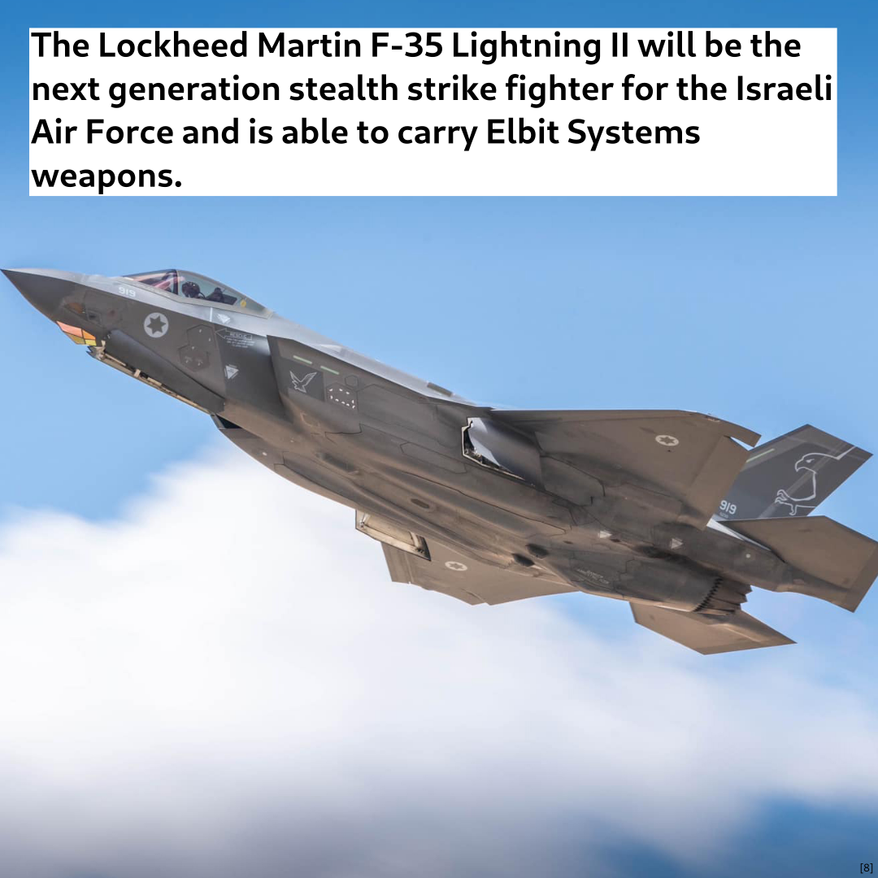

Slide 27
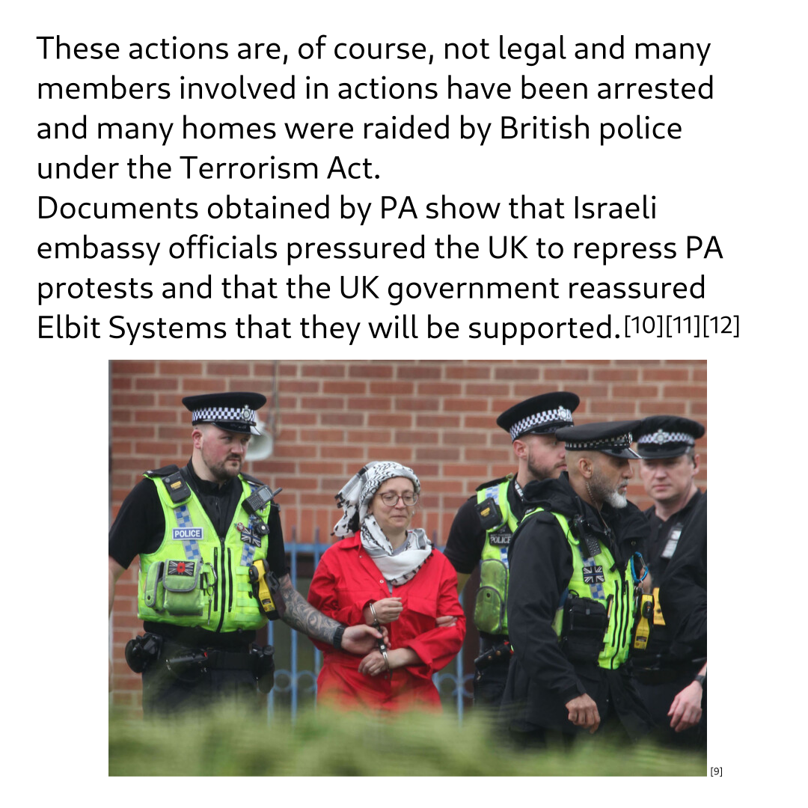

Slide 28
@pal_action
Main website: https://palestineaction.org/
Sources:
[1] https://palestineaction.org/one-year-palestine-action/
[2] https://commons.wikimedia.org/wiki/File:PA-logo-transp-1.png
[3] https://palestineaction.org/israeli-interference/
[4] https://palestineaction.org/
[5] https://www.aljazeera.com/program/newsfeed/2024/4/2/israel-bombs-world-central-kitchen-convoy-killing-foreign-aid-workers
[6] https://palestineaction.org/express-building/
[7] https://palestineaction.org/teledyne-wirral/
[8] https://commons.wikimedia.org/wiki/File:IAF-F-35I-Adir.jpg
[9] https://electronicintifada.net/content/letter-jailed-palestine-activist/48686
[10] https://www.thecanary.co/uk/news/2024/11/19/palestine-action-counter-terror-elbit/
[11] https://www.theguardian.com/uk-news/2023/aug/20/israeli-embassy-officials-attempted-to-influence-uk-court-cases-documents-suggest
[12] https://www.theguardian.com/world/2024/sep/30/activists-say-they-have-proof-ministers-tried-to-influence-police-over-israeli-arms-firm-protests

